Slide 1
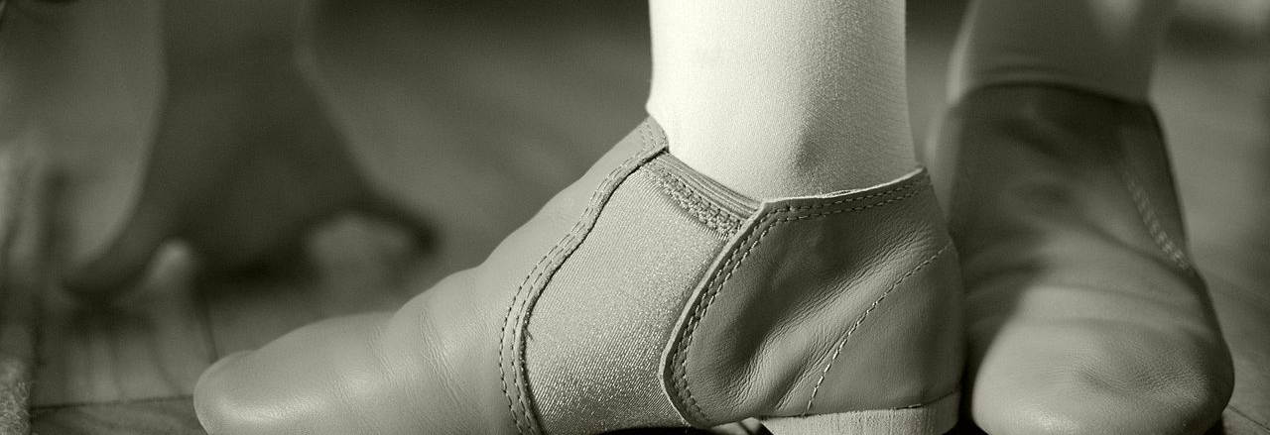


BOOKER MIDDLE SCHOOL
VPA Dance Program
Mr. Batista
941-359-5824 EXT.60951
PEDRO.BATISTA@SARASOTACOUNTYSCHOOLS.NET

Slide 2

What to Place on the Note Card!
  Name/ N#:
  Parents’ Names:
  Home phone #:
  Any cell #’s or other ways to reach the dancers or your parents:
  Address: (Where you live with parents or guardian)
  1st Period Teacher/Team:
  Summer Training (How Long?):
  Write down one thing you learned from any training or from this summer?:
  Any other info I should know, ex: injuries:
On the Back:
Write down three goals that you have for yourself as a student/dancer for this year, and what steps you think you need to take to get there. If you do not know of the goals now, try to think of what your goals might be in a few weeks.

Slide 3
Table of contents
COURSE DESCRIPTION
CLASSROOM EXPECATIONS
  DANCE CLASS ETIQUETTES
  CLASSROOM PROCEDURES
DAILY SCHEDULE FOR VPA STUDENTS/DANCERS
GRADING SYSTEM
ENRICHMENT FEE
INCENTIVES/REWARDS
PERFORMANCE OPPORTUNITIES

Slide 4
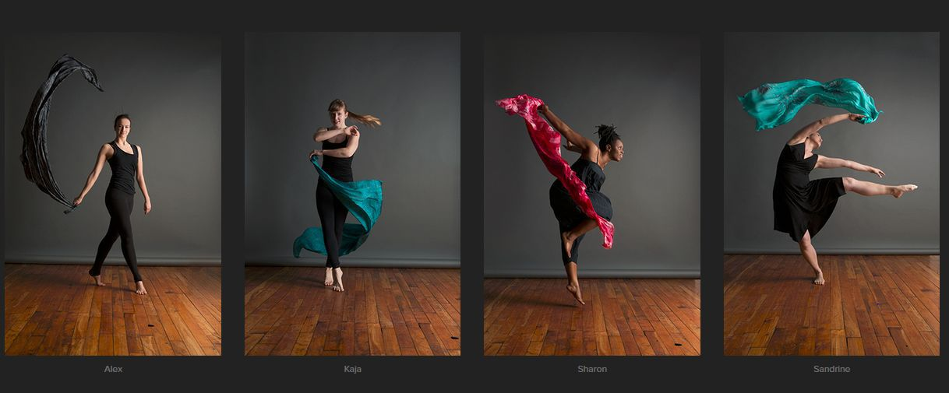
Course Description
VPA Dance at Booker Middle consists of various types of dance forms
strong emphasis on ballet technique
-provides groundwork for learning other styles
-Rommett Floor Barre
modern (Horton, Graham, Limon, Contemporary)
jazz (Latin Jazz, Bollywood, Musical Theatre)
improvisation and choreography
Hip-hop (Tutting, Popping and Locking)
Dance Aerobics (Acro, Strengthening and Conditioning)
Ballroom (Salsa, Merguene, Waltz, Foxtroit)

Slide 5
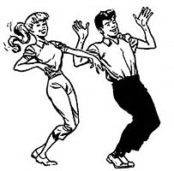
Course Description
Students’ Success criteria will allow:
An understanding on how these dance styles and forms impact our society today and through history.
an overview of dance vocabulary and composition, dance history, anatomy, and music appreciation throughout the course of this program.
The goal of producing students who will continue to love dance as audience members, choreographers, dance critics, dance therapists, dance teachers, as well as professional dancers.

Slide 6
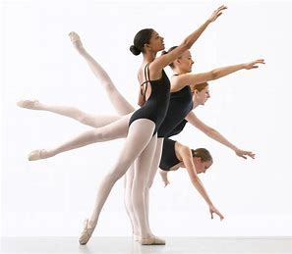
Primary Styles
Ballet (Classical, Contemporary, Floor-Barre)
  Focus on classical technique under the ABT National Training Curriculum.
  studying Rommett Floor-Barre™
  Utilizing the floor, without the pressure of gravity and combines classical ballet with anatomical principles of alignment.
    body refinement and improvement training
    properly corrects placement
    strengthens joints
    corrects muscles

Slide 7
Primary Styles
Modern (Horton, Graham, Limon, Contemporary)
focuses on correct alignment
moving freely through the space
exploring new ways of moving.
Concentration on Horton modern technique
  Fortifies, stretches and reshapes the body
  Helps produce an accomplished dancer
  Builds well-placed dancers capable of a broad range of expression
  Allow dancer to Demonstrates impressive technical skills
  Trains dancers that readily adapt to any other dance forms

Slide 8
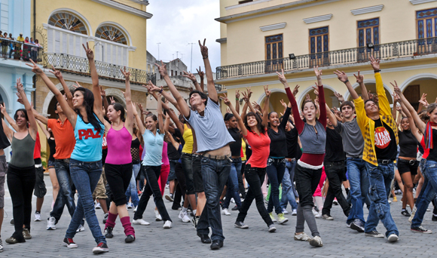
Primary Styles
Jazz (Latin Jazz, Bollywood, Musical Theatre, Hip-hop)
energetic and exciting class
technical focus on alignment, strength, and phrasing.
include Isolations warm-up with emphasis on abdominal and upper body strength as well as flexibility
control of the entire body
styles are influenced by classical jazz, Latin, modern, and musical theatre styles
improve and emphasize diversity in movement qualities and dynamics.

Slide 9
Classroom Expectations
Respect your classmates, your teachers and your (work) space.
use positive words for yourself and others.
You must be properly dressed out for class, without jewelry.
    NO JEWELRY (Including rings, bracelets, anklets, and silly bands)
Keep track of all personal belongings
    (YOU are in charge of your own personal belongings)
    (Ex. write your names in your shoes & clothing with black permanent marker)
Food, drinks, gum, street shoes and negative attitudes should NOT be brought into the classroom. If you need to eat a snack, then eat it over the trash can, please.
    (Bottled water is allowed, BUT absolutely NO Eating in the Dressing rooms, you will lose your dressing room privileges)

Slide 10
Classroom Expectations
Be in control of your voice, mind, body, and space at all times.
Voice, Mind, Body, Space
Voice- Express yourself through your movements, not your voices.
Mind- Stay focused and concentrated, be on task.
Body- Keep your hands and feet to yourself
Space - Stay in your “personal dance space” and in your own area.
Due to the nature of the class, physical corrections will be made by vocal corrections, demonstrations and TOUCH. These will be appropriate for the correction. If you have any issues on being corrected by physical TOUCH, please inform me of this immediately (in private if need be).

Slide 11
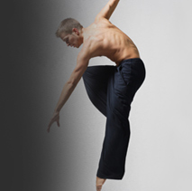
Dance Class Etiquettes
No Chatter During Class
Arrive to class on time (Being Tardy or Absent from Rehearsal)
Be fully prepared for the appropriate class
(No Inappropriate Attire)
No Cliques
Have Proper Spacing in Class
Respect your teacher and the lesson you are being taught
Respect your fellow dancers/students and the work they are doing
Participate in the class to the fullest of your ability
Show Révérence to the art form of Dance

Slide 12

SPECIAL NOTE REGARDING CELL PHONES…
CELL PHONES ARE TO BE SILENCED, turned off AND put AWAY in your book bags.
In keeping with Booker Middle School campus policy, any phones that ring, are used, consulted, or seen during class or in the dressing rooms will be confiscated and delivered to the main office where a parent or guardian must pick them up.
(If I see any cell phones out in the dressing rooms, THEY WILL BE MINE!!! As per our vpa contract/student agenda books rules that I have already read to you.)

Slide 13
Restroom/Water Breaks
There is plenty of time to use the restroom when you are changing out. Please do so then, instead of interrupting class time. IF YOU NEED TO USE THE RESTROOM FOR EMERGENCIES ONLY, YOU NEED TO ASK BEFORE YOU GO. Please keep a bottle of water nearby.
student/dancer observations
When you have a valid excuse for not being able to physically dance, you must write an observation. You may be given questions or topics to write about. This must be dated and turned in at the end of class. You will still receive deductions on your participation grade, but you will learn the concepts needed for any movement learned from class.

Slide 14

PLEASE FOLLOW THESE Entering Procedures
Come into the classroom QUIETLY, and take off your shoes
Place all belongings in your lockers including, your book bags, jewelry, cell phones and personal belongings.
Check the Active-Panel for bell-work if there is any assignments; take out your folders/binders to write in; if not, go get changed and get ready to dance.
Dress out and change in the dressing rooms (Take with you ONLY your dance clothes to change, leave your book bags and shoes in the classroom area and in your lockers)
When you are dressed, come onto the dance floor to your assigned barre area (or sit in a circle) and wait quietly for the rest of the class and warm-up and stretch on your own.

Slide 15
Other Signals & Procedures
Quiet Signals
If you hear me talking, you are quiet.
I’ll Say, Clap once if you can hear me…etc
If you see my hand go up, you are quiet.
If you hear me clap, you repeat, and you are quiet.
If someone else is talking, you are quiet.
Begin Class/Attendance Procedures
Sit in your assigned barre area or rows. I will inform you or put on the mirrors which row is in front. After you are in the front, the following week, you move to the back, and we rotate this way or when asked to rotate by the teacher.
Exiting Procedures
Follow the teacher for Réverénce (showing respect, appreciation, and thanks to your teacher and classmates or audience).
Clap and personally thank your teacher.
Make sure the room is clean and any materials you used are put away.
Gather all of your belongings and get changed back in the dressing rooms or rest rooms
Campus Transitions/Evacuation procedures
Put only your shoes on. Make sure they are completely on (the backs, tied laces, etc.)
Leave all other belongings in the classroom including your cell phone (you may take a purse or wallet if you have one)
Line up in a single file line quietly against the west lockers.
Listen for further directions.

Slide 16
Daily Schedule for VPA Students
Mon, Wednesday and Thurs
Ballet Technique under the ABT National Training Curriculum and Floor-Barre under the Zena Rommett Floor-Barre™ OR work on the Rehearsal process.
This may vary depending on how hard you are working throughout the week.
Wear black leotard, pink or skin colored tights, ballet shoes, hair in bun or high ponytail, ballet skirt is permitted, no jewelry. (Boys wear black dance pants or shorts and black or white t-shirt, with black ballet shoes or bare feet, no socks. Unless specified)
Tuesday and Friday
Modern/Horton/Contemporary/ Jazz/ Choreography/ Composition
(We may do dance history, or another form of dance related to the unit we are doing at the time)
You may put your black pants over your leotard and tights. You may be barefoot for Modern or wear jazz shoes For Jazz Class. (Boys wear black pants or shorts and may be barefoot or wear black jazz or ballet shoes occasionally if preferred.)
NO JEWELRY, NO GUM WHATSOEVER. Your hair must be up and out of your face

Slide 17
Daily Schedule for Encore Students
Mon, Wednesday and Thurs
Ballet Technique under the ABT National Training Curriculum and Floor-Barre under the Zena Rommett Floor-Barre™ OR work on the Rehearsal process.
This may vary depending on how hard you are working throughout the week.
Wear black leotard, pink or skin colored tights, ballet shoes, hair in bun or high ponytail, ballet skirt is permitted, no jewelry. (Boys wear black dance pants or shorts and black or white t-shirt, with black ballet shoes or bare feet, no socks. Unless specified)
Tuesday and Friday
Modern/Horton/Contemporary/ Jazz/ Choreography/ Composition
(We may do dance history, or another form of dance related to the unit we are doing at the time)
You may put your black pants over your leotard and tights. You may be barefoot for Modern or wear jazz shoes For Jazz Class. (Boys wear black pants or shorts and may be barefoot or wear black jazz or ballet shoes occasionally if preferred.)
NO JEWELRY, NO GUM WHATSOEVER. Your hair must be up and out of your face

Slide 18
Grading System
Dancers (are):
graded on Participation Daily (-5 Pts per day)
Graded also on work effort & attitude
excused from participating from class ONLY with a written excuse from a doctor
A parent note does not excuse you from dressing out.
grade is affected by each unapproved non-participation. This includes Proper Dance Attire and you are to Participate.
Dancers:
must have Attendance, that’s why it’s called attend dance in order to learn.
Students will be deducted 5 points from their attendance grade for every UNEXCUSED ABSENCE.
Only documented excused absences will be taken into consideration
If you are absent, it is your job to find out what you missed and if there is anything that you need to make up.
Other areas of grading
Each dancer will keep a journal, for taking notes and storing handouts. You are allowed to take them home to study.
In addition to these sections, there are quizzes, tests, projects, group work, and papers. There is usually 1-2 of each per grading period.
Students are also graded on their rehearsals and performances. (50 pts each)

Slide 19
Consequences for Inappropriate Behavior
After the first infraction, the student will receive a warning. This is your Warning!!!! DON’T DO IT PERIOD! IN Class and on campus!
After the 2nd infraction, the parent will be contacted by the teacher via phone, or email/letter of concerns after the dancer has refocused, along with a written SIRS!
After the 3rd infraction, a referral will be written along with a written SIRS and the dancer will have an administrator oversee the consequences for the infraction. (This may or will result in the removal of you from dance pieces and/or the Vpa concerts.)

Slide 20
Consequences for Inappropriate Behavior
After the 4th infraction, there will be another written referral along with a written sir and the student will again be addressed by an administration. . (This results in the removal of the VPA Dance Concerts and on probation of the vpa program.)
After 5 infractions of the guidelines, if a student does not comply with my expectations of behavior IN & OUT of my class, (including ISR, OSS or other written SIRS or Referrals by other teachers), they will not be a part of the Dance Program. I will only have students that show me why they deserve to be a part of this program based on their attitude and their actions.

Slide 21
Enrichment Fees/Incentives Reward
Enrichment Fee
Each VPA Dance student will be responsible for a $30 enrichment fee for the entire year; which will go towards the production cost for the rental of the Booker High School VPA Theatre, costumes & buses for field trips taken this year. Please return this item to Mr. Batista no later than Friday, November 1st.
Incentives/ Rewards
Performing is a privilege. You will be auditioned and invited to perform if you are doing the very best you can and putting forth 100% effort. You may even be asked to do a solo, duet, trio, or quartet. The students who I think can handle the extra pressure and show how much they want to be here, will be the ones who will get the extra chances. Fieldtrips and master classes are also Included In Rewards

Slide 22
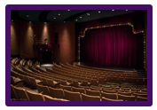
Performance Opportunity
The date and time for the Winter Concert is on Saturday, Jan. 11th at 7:00 pm
The date and time for the Spring Concert is on Saturday, May 16th at 7:00 pm
Please plan for you to stay after-school some days during the weeks before the show until the latest 5:30 pm.
Start making transportation arrangements now. This year our concert will be held @ Booker High School and so it is very important that transportation arrangements are made.

Slide 23
My Contact Information
I like to stay in very close contact with parents through email. So, please include your email address at the bottom of this page. Please get in touch with me if you have any questions, concerns, thoughts, ideas, or just want to hear how your dancer is progressing in class.
Please email me at Pedro_Batista@sarasotacountyschools.net Or call me at Booker Middle at 941-359-5824 ext. 60951
Please remove, sign and date stating that you have read the entire packet and commit to being a part of this program. Please provide your phone number and email, so that I can relay important information.
--------------------------------------------------------------------------------------------------------------------------------------
Student ______________________________________ Date____________
Parent________________________________________ Date____________
Phone Number_______________ Email_________________________

